Slide 1

Chapter 4
Mathematics of Cryptography
Part II: Algebraic Structures
4.<number>
Copyright © The McGraw-Hill Companies, Inc. Permission required for reproduction or display.

Slide 2
Chapter 4
Objectives
❏ To review the concept of algebraic structures
❏ To define and give some examples of groups
❏ To define and give some examples of rings
❏ To define and give some examples of fields
❏ To emphasize the finite fields of type GF(2^{n})
that make it possible to perform operations such
as addition, subtraction, multiplication, and
division on n-bit words in modern block ciphers
4.<number>

Slide 3
4-1 ALGEBRAIC STRUCTURES
Cryptography requires sets of integers and specific operations that are defined for those sets. The combination of the set and the operations that are applied to the elements of the set is called an algebraic structure. In this chapter, we will define three common algebraic structures: groups, rings, and fields.
Topics discussed in this section:
4.1.1 Groups
4.1.2 Rings
4.1.3 Fields
4.<number>

Slide 4
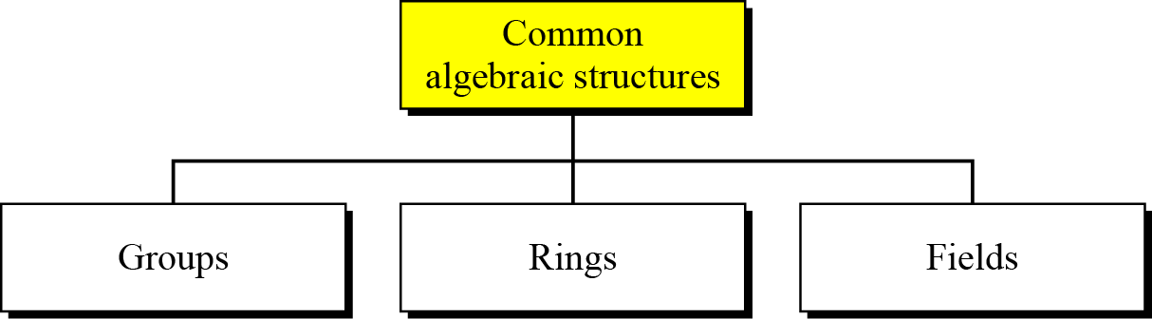
4.1 Continued
Figure 4.1 Common algebraic structure
4.<number>

Slide 5
4.1.1 Groups
A group (G) is a set of elements with a binary operation (•) that satisfies four properties (or axioms). A commutative group satisfies an extra property, commutativity:
❏ Closure:
❏ Associativity:
❏ Commutativity:
❏ Existence of identity:
❏ Existence of inverse:
4.<number>

Slide 6
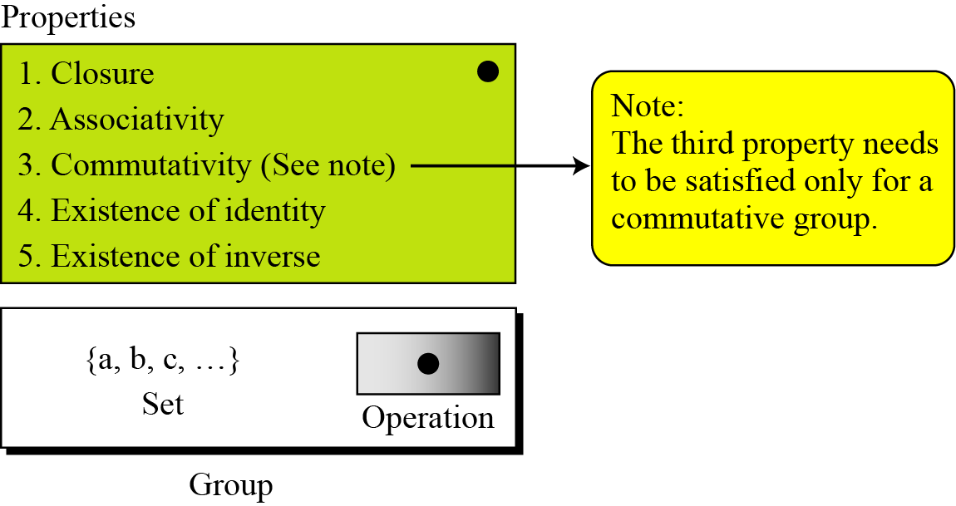
4.1.1 Continued
Figure 4.2 Group
4.<number>

Slide 7
4.1.1 Continued
Application
Although a group involves a single operation, the properties imposed on the operation allow the use of a pair of operations as long as they are inverses of each other.
Example 4.1
The set of residue integers with the addition operator,
G = < Z_{n} , +>,
is a commutative group. We can perform addition and subtraction on the elements of this set without moving out of the set.
4.<number>

Slide 8
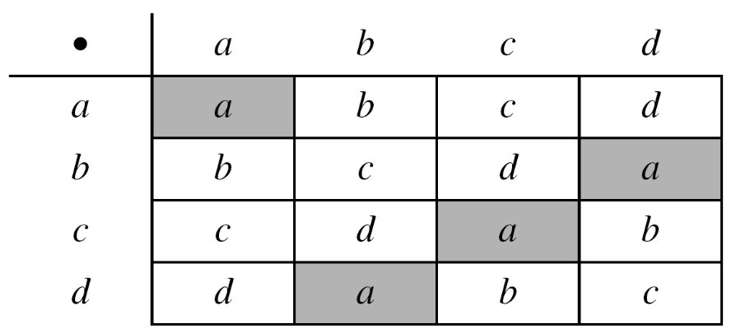
4.1.1 Continued
Example 4.2
The set Zn* with the multiplication operator, G = <Zn*, ×>, is also an abelian group.
Example 4.3
Let us define a set G = < {a, b, c, d}, •> and the operation as shown in Table 4.1.
4.<number>

Slide 9
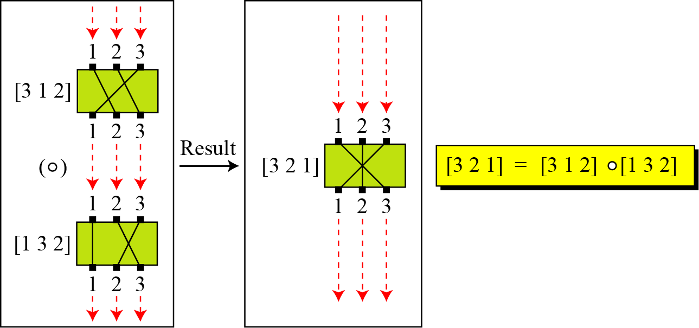
4.1.1 Continued
Example 4.4
A very interesting group is the permutation group. The set is the set of all permutations, and the operation is composition: applying one permutation after another.
Figure 4.3 Composition of permutation (Exercise 4.4)
4.<number>

Slide 10
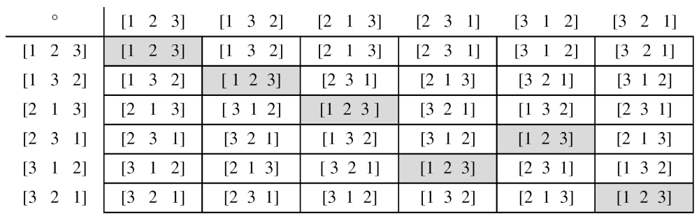
4.1.1 Continued
Example 4.4
Continued
Table 4.2 Operation table for permutation group
4.<number>

Slide 11
4.1.1 Continued
Example 4.5
In the previous example, we showed that a set of permutations with the composition operation is a group. This implies that using two permutations one after another cannot strengthen the security
of a cipher, because we can always find a permutation that can do the same job because of the closure property.
4.<number>

Slide 12
4.1.1 Continued
Finite Group
Order of a Group
Subgroups
4.<number>

Slide 13
4.1.1 Continued
Example 4.6
Is the group H = <Z₁₀, +> a subgroup of the group G = <Z12, +>?
Solution
The answer is no. Although H is a subset of G, the operations defined for these two groups are different. The operation in H is addition modulo 10; the operation in G is addition modulo 12.
4.<number>

Slide 14
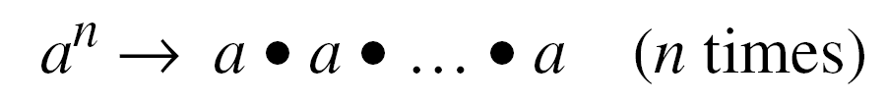
4.1.1 Continued
Cyclic Subgroups
If a subgroup of a group can be generated using the power of an element, the subgroup is called the cyclic subgroup.
4.<number>

Slide 15
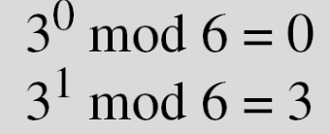

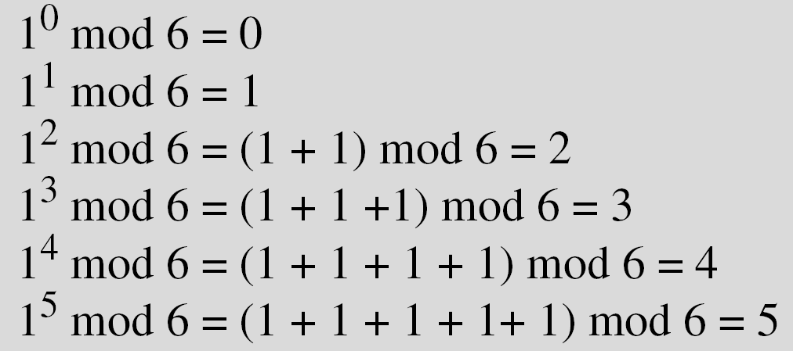
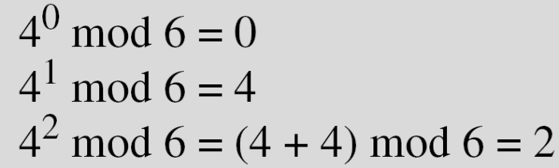
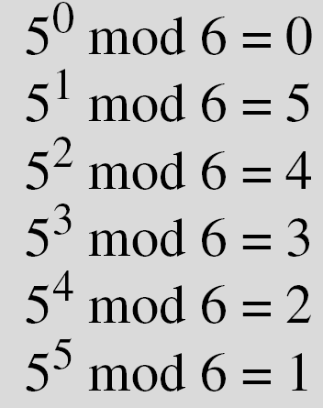
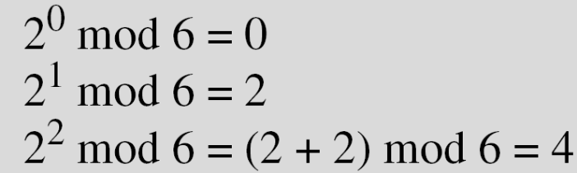
4.1.1 Continued
Example 4.7
Four cyclic subgroups can be made from the group G = <Z6, +>. They are H1 = <{0}, +>, H2 = <{0, 2, 4}, +>, H₃ = <{0, 3}, +>, and H4 = G.
4.<number>

Slide 16
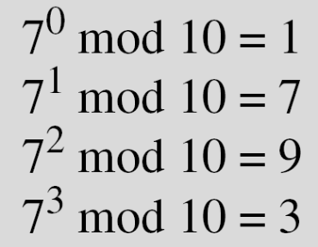

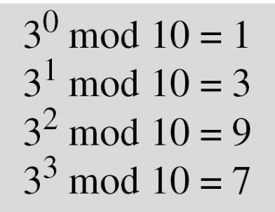
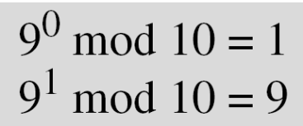
4.1.1 Continued
Example 4.8
Three cyclic subgroups can be made from the group
G = <Z10∗, ×>. G has only four elements: 1, 3, 7, and 9. The cyclic subgroups are H1 = <{1}, ×>, H2 = <{1, 9}, ×>, and H3 = G.
4.<number>

Slide 17
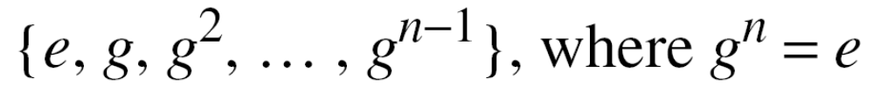
4.1.1 Continued
Cyclic Groups
A cyclic group is a group that is its own cyclic subgroup.
4.<number>

Slide 18
4.1.1 Continued
Example 4.9
Three cyclic subgroups can be made from the group
G = <Z10∗, ×>. G has only four elements: 1, 3, 7, and 9. The cyclic subgroups are H1 = <{1}, ×>, H2 = <{1, 9}, ×>, and H3 = G.
a. The group G = <Z6, +> is a cyclic group with two generators,
g = 1 and g = 5.
b. The group G = <Z10∗, ×> is a cyclic group with two generators,
g = 3 and g = 7.
4.<number>

Slide 19
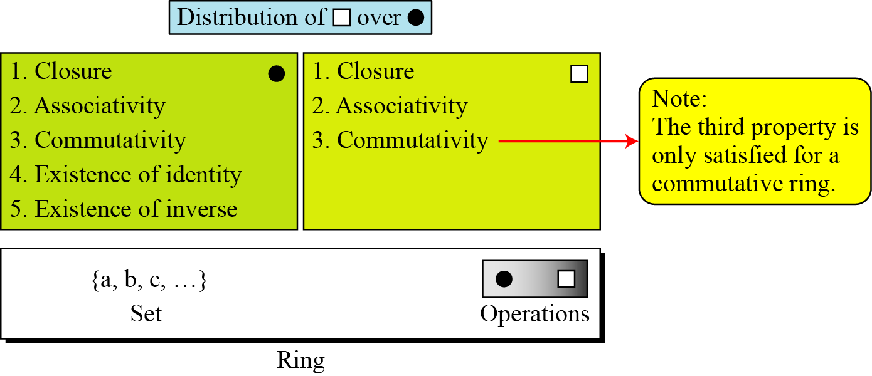
4.1.2 Ring
A ring, R = <{…}, •, _x0001_>, is an algebraic structure with two operations.
Figure 4.4 Ring
4.<number>

Slide 20
4.1.2 Continued
Example 4.11
The set Z with two operations, addition and multiplication, is a commutative ring. We show it by R = <Z, +, ×>. Addition satisfies all of the five properties; multiplication satisfies only three properties.
4.<number>

Slide 21
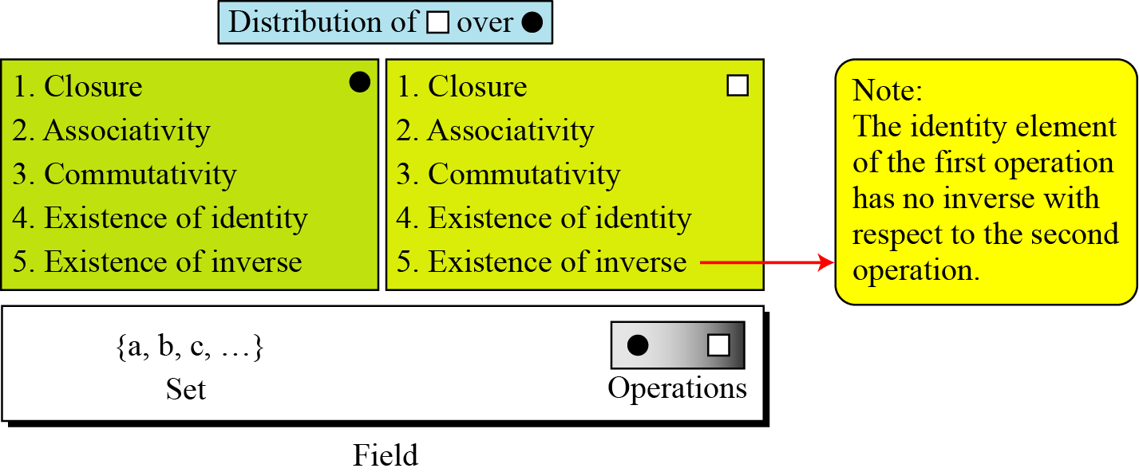
4.1.3 Field
A field, denoted by F = <{…}, •, _x0001_> is a commutative ring in which the second operation satisfies all five properties defined for the first operation except that the identity of the first operation has no inverse.
Figure 4.5 Field
4.<number>

Slide 22

4.1.3 Continued
Finite Fields
Galois showed that for a field to be finite, the number of elements should be p^{n}, where p is a prime and n is a positive integer.
Note
A Galois field, GF(p^{n}), is a finite field with p^{n} elements.
4.<number>

Slide 23
4.1.3 Continued
GF(p) Fields
When n = 1, we have GF(p) field. This field can be the set Z_{p}, {0, 1, …, p − 1}, with two arithmetic operations.
4.<number>

Slide 24
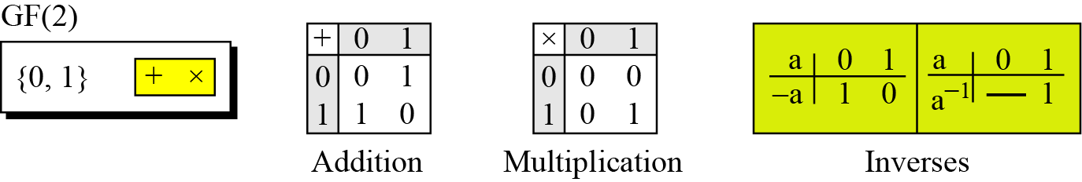
4.1.2 Continued
Example 4.12
A very common field in this category is GF(2) with the set {0, 1} and two operations, addition and multiplication, as shown in Figure 4.6.
Figure 4.6 GF(2) field
4.<number>

Slide 25
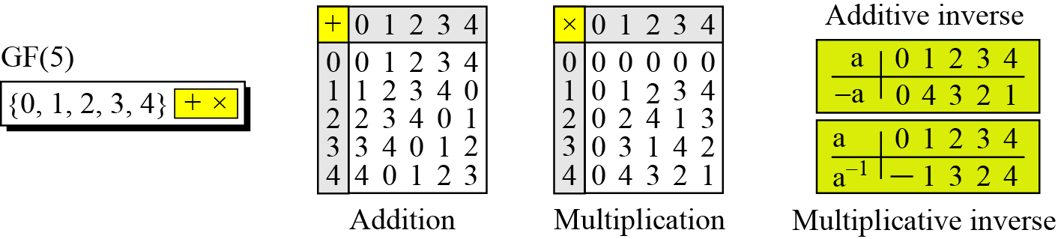
4.1.2 Continued
Example 4.13
We can define GF(5) on the set Z₅ (5 is a prime) with addition and multiplication operators as shown in Figure 4.7.
Figure 4.7 GF(5) field
4.<number>

Slide 26
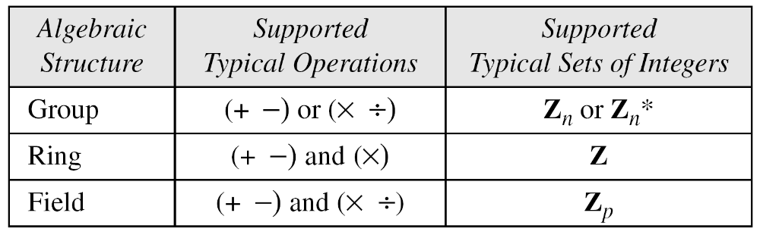
4.1.3 Continued
Summary
Table 4.3 Summary
4.<number>

Slide 27
4-2 GF(2^{n}) FIELDS
In cryptography, we often need to use four operations (addition, subtraction, multiplication, and division). In other words, we need to use fields. We can work in GF(2^{n}) and uses a set of 2^{n} elements. The elements in this set are n-bit words.
Topics discussed in this section:
4.2.1 Polynomials
4.2.2 Using A Generator
4.2.3 Summary
4.<number>

Slide 28
4.2.1 Polynomials
A polynomial of degree n − 1 is an expression
of the form
where x^{i} is called the ith term and a_{i} is called coefficient of the ith term.
4.<number>

Slide 29
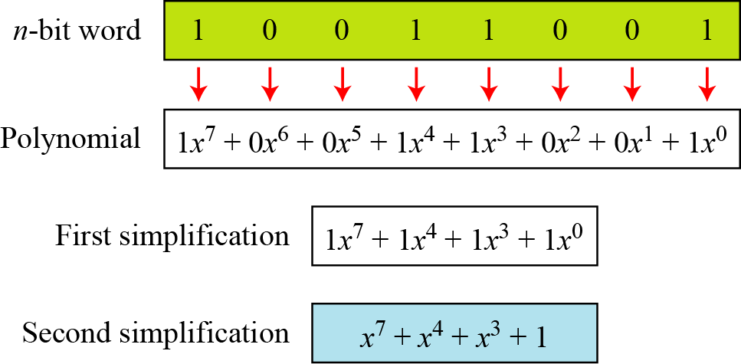
4.2.1 Continued
Example 4.15
Figure 4.9 show how we can represent the 8-bit word (10011001) using a polynomials.
Figure 4.9 Representation of an 8-bit word by a polynomial
4.<number>

Slide 30
4.2.1 Continued
Example 4.16
To find the 8-bit word related to the polynomial x⁵ + x² + x, we first supply the omitted terms. Since n = 8, it means the polynomial is of degree 7. The expanded polynomial is
This is related to the 8-bit word 00100110.
4.<number>

Slide 31
4.2.1 Continued
GF(2^{n}) Fields
Note
Polynomials representing n-bit words use two fields: GF(2) and GF(2^{n}).
4.<number>

Slide 32
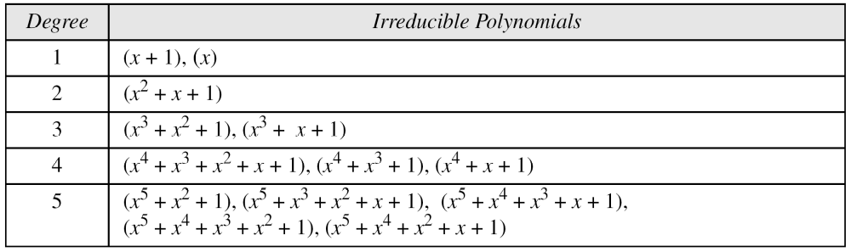
4.2.1 Continued
Modulus
For the sets of polynomials in GF(2^{n}), a group of polynomials of degree n is defined as the modulus. Such polynomials are referred to as irreducible polynomials.
Table 4.9 List of irreducible polynomials
4.<number>

Slide 33
4.2.1 Continued
Addition
Note
Addition and subtraction operations on polynomials are the same operation.
4.<number>

Slide 34
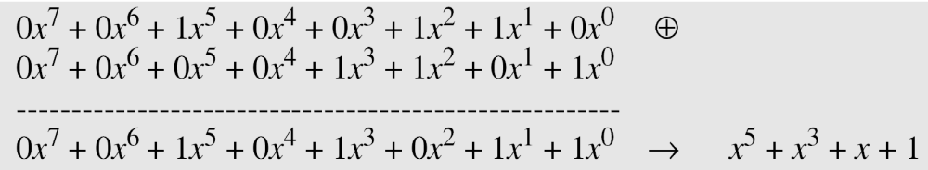
4.2.1 Continued
Example 4.17
Let us do (x⁵ + x² + x) ⊕ (x³ + x² + 1) in GF(2⁸). We use the symbol ⊕ to show that we mean polynomial addition. The following shows the procedure:
4.<number>

Slide 35
4.2.1 Continued
Example 4.18
There is also another short cut. Because the addition in GF(2) means the exclusive-or (XOR) operation. So we can exclusive-or the two words, bits by bits, to get the result. In the previous example, x⁵ + x² + x is 00100110 and x³ + x² + 1 is 00001101. The result is 00101011 or in polynomial notation x⁵ + x³ + x + 1.
4.<number>

Slide 36
4.2.1 Continued
Multliplication
1. The coefficient multiplication is done in GF(2).
2. The multiplying x^{i} by x^{j} results in x^{i+j}.
3. The multiplication may create terms with degree more than n − 1, which means the result needs to be reduced using a modulus polynomial.
4.<number>

Slide 37
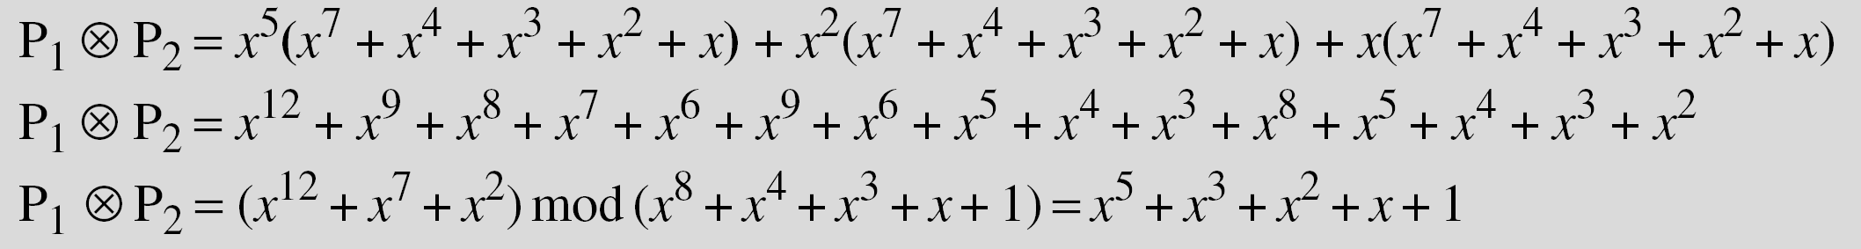
4.2.1 Continued
Example 4.19
Find the result of (x⁵ + x² + x) ⊗ (x⁷ + x⁴ + x³ + x² + x) in GF(2⁸) with irreducible polynomial (x⁸ + x⁴ + x³ + x + 1). Note that we use the symbol ⊗ to show the multiplication of two polynomials.
Solution
To find the final result, divide the polynomial of degree 12 by the polynomial of degree 8 (the modulus) and keep only the remainder. Figure 4.10 shows the process of division.
4.<number>

Slide 38
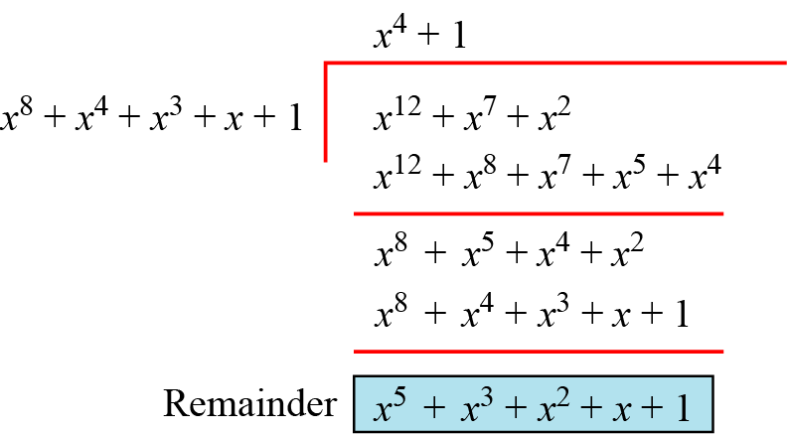
4.2.1 Continued
Figure 4.10 Polynomial division with coefficients in GF(2)
4.<number>

Slide 39
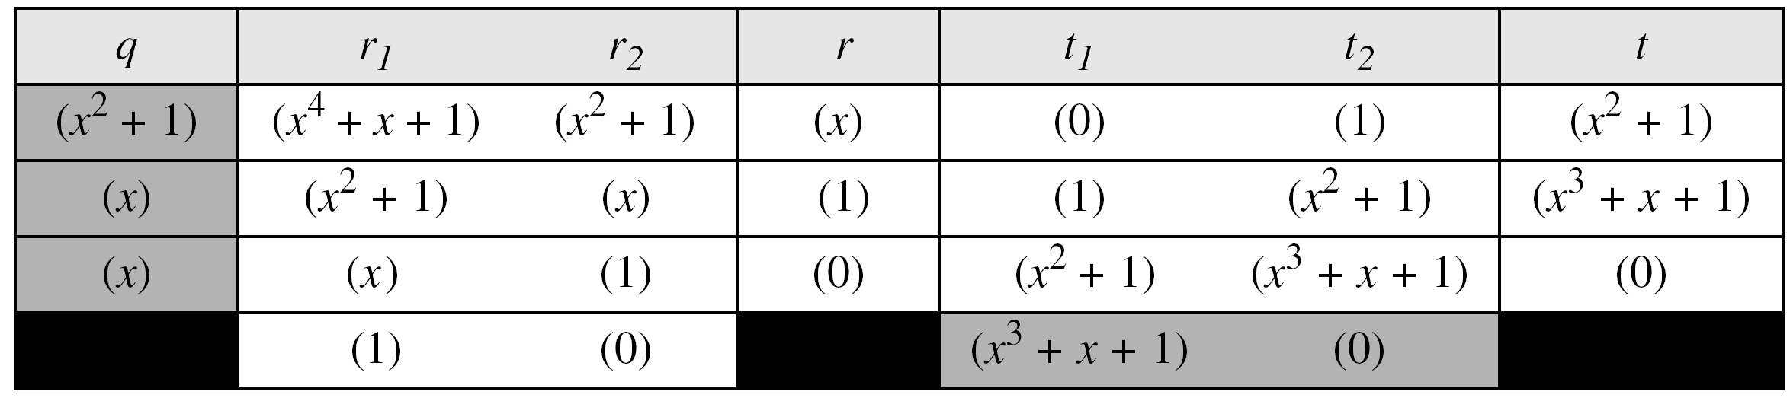
4.2.1 Continued
Example 4.20
In GF (2⁴), find the inverse of (x² + 1) modulo (x⁴ + x + 1).
Solution
The answer is (x³ + x + 1) as shown in Table 4.5.
Table 4.5 Euclidean algorithm for Exercise 4.20
4.<number>

Slide 40
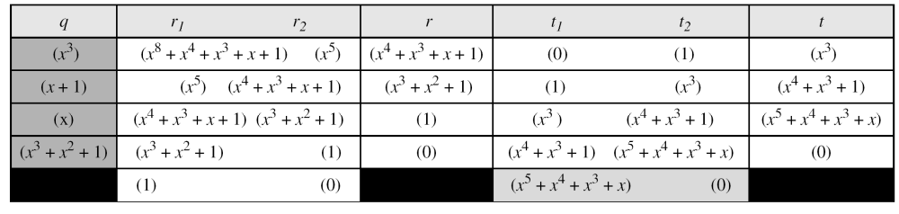
4.2.1 Continued
Example 4.21
In GF(2⁸), find the inverse of (x⁵) modulo (x⁸ + x⁴ + x³ + x + 1).
Solution
The answer is (x⁵ + x⁴ + x³ + x) as shown in Table 4.6.
Table 4.6 Euclidean algorithm for Exercise 4.21
4.<number>

